Slide 1

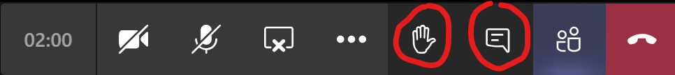
An Introduction to Python
Please mute your microphone and turn your video off
Click the Show conversation button if you want to ask any questions during the session

Slide 2
Session Outline
Overview of Python
Using simple commands
Creating and using variables
Creating a simple program

Slide 3
What is Python?
It’s an easy-to-use language that makes it simple to get your program working
It runs anywhere
It’s open source
Available from www.python.org
Version 3.8.x is the latest version
Documentation and free online tutorials are available
Notes:
https://wiki.python.org/moin/BeginnersGuide/Overview
Python is a clear and powerful object-oriented programming language, comparable to Perl, Ruby, Scheme, or Java.
Is an easy-to-use language that makes it simple to get your program working. This makes Python ideal for prototype development and other ad-hoc programming tasks, without compromising maintainability.
Comes with a large standard library that supports many common programming tasks such as connecting to web servers, searching text with regular expressions, reading and modifying files.
Runs anywhere, including Mac OS X, Windows, Linux, and Unix, with unofficial builds also available for Android and iOS.
s free software in two senses. It doesn't cost anything to download or use Python, or to include it in your application. Python can also be freely modified and re-distributed, because while the language is copyrighted it's available under an open source license.

Slide 4
Try some of these in IDLE
Change font size: Options>Configure IDLE
Use ALT + P to scroll through previous commands
Maths
5 + 5 * 3
5**3
5/3
5//3
help(“round”)
round(5/3, 1)
Strings
“pine” + “apple”
“10” + “10”
4 * “10”

Slide 5
Functions and Modules
print
help("print")
print("Hello World")
print(4 * 5)
print("The answer is ", 6*7, "!", sep = "")
math.sqrt
help(“modules”)
help("math")
import math
math.sqrt(9)
input
input("What is your name? ")

Slide 6
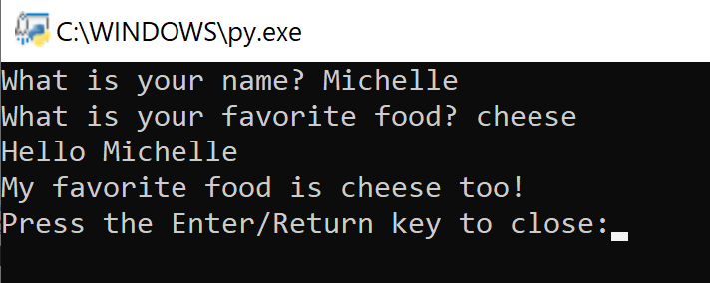
Exercise One
Create a program to ask for your favourite type of food, and print the result
Hints:
File>New File
Need a variable (name cannot have spaces)
Print out the result to the shell
Save, then Run>Run Module to test
Alternatively, try this:
Make a copy of FirstProgram.py
Right-click>Edit with IDLE
Modify the code to do something like this

Slide 7
Exercise Two
Create a program to convert US Dollars to UK Pounds
Hints:
File>New File
Need variables
Need to get input, int() or a float()
Print out the result to the shell
Comment your code #

Slide 8
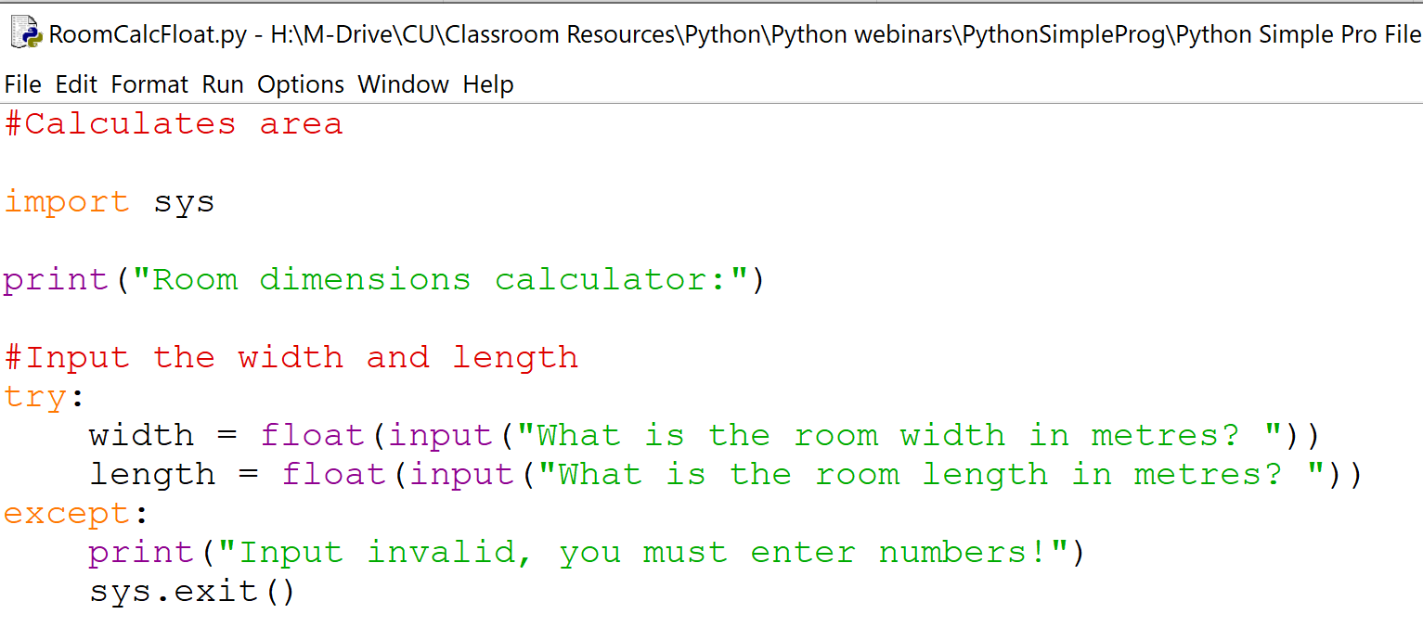
Error Catching
Open RoomCalcFloat.py
Modify the code:
import sys
try the input commands
Use except to handle errors
print an error message
Use sys.exit() to quit if input is invalid

